Slide 1
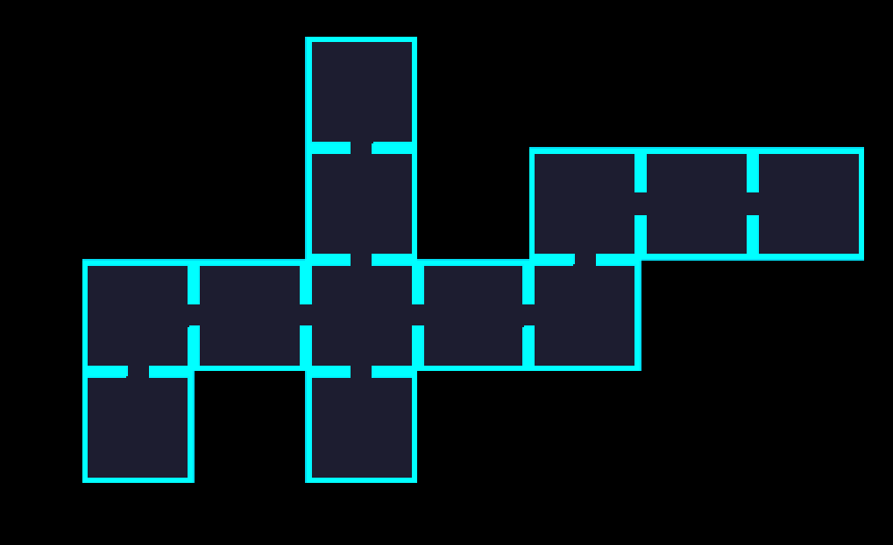
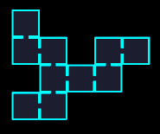
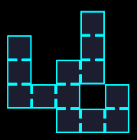
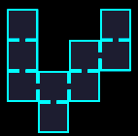

A New Way To Generate Levels
By Edgar Murga

Slide 2


Slide 3


Slide 4
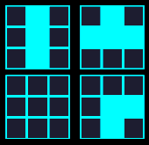

Wave Function Collapse:
Database:
Starting Point:

Slide 5
Wave Function Collapse:
Database:
Chosen Path
Possible Pieces

Slide 6

Wave Function Collapse:
Database:
Chosen Path
Possible Pieces

Slide 7
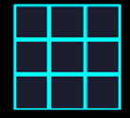

Wave Function Collapse:
Result:

Slide 8
Cellular Automata
Wall Cell:
Floor Cell:

Slide 9
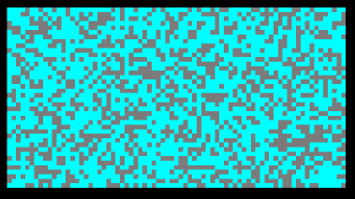
Cellular Automata
Wall Cell:
Floor Cell:
Random Grid

Slide 10
Cellular Automata
Neighbours:
Mostly Wall:
Mostly Floor:
Next State

Slide 11
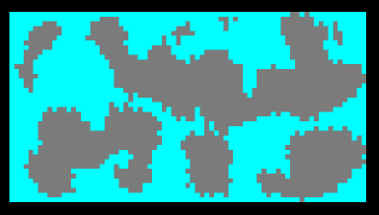
Cellular Automata
Wall Cell:
Floor Cell:
Random Grid
Result

Slide 12
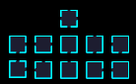
Best of Both Worlds
Cellular Automata:
Cellular Automata:
Grid:
Database:

Slide 13

Best of Both Worlds
Cellular Automata:
Wave Function Collapse:
Grid:
Database:
Piece Matching:
Neighbour Checks

Slide 14

Final Algorithm
Middle Room:

Slide 15
Chosen Path

Slide 16
Free Spot:

Slide 17

Fitting Room:

Slide 19
No Spot:

Slide 20

Door:

Slide 21



New Branch

Slide 22

Rest of Level

Slide 23
The End

